Slide 1




DEPARTMENT OF ARTIFICIAL INTELLIGENCE AND MACHINE LEARNING
SWARNANDHRA COLLEGE OF ENGINEERING&TECHNOLOGY
WEATHER APP
Under the guidance of: Submitted by:
Ms. B.Haritha Posimsetti B V V Lakshmi 22A21A6184
M.Tech Tiruveedula Dinesh-22A21A61B0
Assistant Professor Satti MaheswaraReddy-22A21A6199
Surampudi V S Tejasri-23A25A6114
Pulaparthi R L N Manikanta-22A21A6187

Slide 2




Agenda:
Introduction
Abstract
Architecture
Dataset
UML Diagrams
Code Screenshots
Experimental Results
Conclusion
Reference

Slide 3

Introduction:
The weather app provides real-time weather updates based on user input or location.
Key features include current temperature, humidity, wind speed.
Built using HTML, CSS, JavaScript, and integrates with the OpenWeatherMap API.

Slide 4

Abstract:
This project aims to develop a weather app that delivers real-time weather information. Users can search for conditions in any city and check the weather for their current location using data from an external API. With a focus on simplicity, the app provides essential details like temperature, wind speed, and humidity for quick and accurate updates.

Slide 5

Architecture:
The frontend is developed using HTML, CSS, and JavaScript to create the user interface.
Weather data is obtained from the OpenWeatherMap API.
The app operates on a request-response model: user searches → API request → data display.

Slide 6

Dataset used:
The frontend is developed using HTML, CSS, and JavaScript to create the user interface.
Weather data is obtained from the OpenWeatherMap API.
The app operates on a request-response model: user searches → API request → data display.

Slide 7
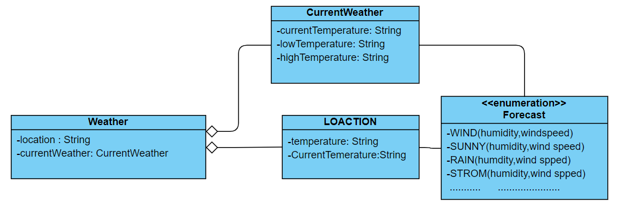
UML Diagram:
a
y
c
c

Slide 8
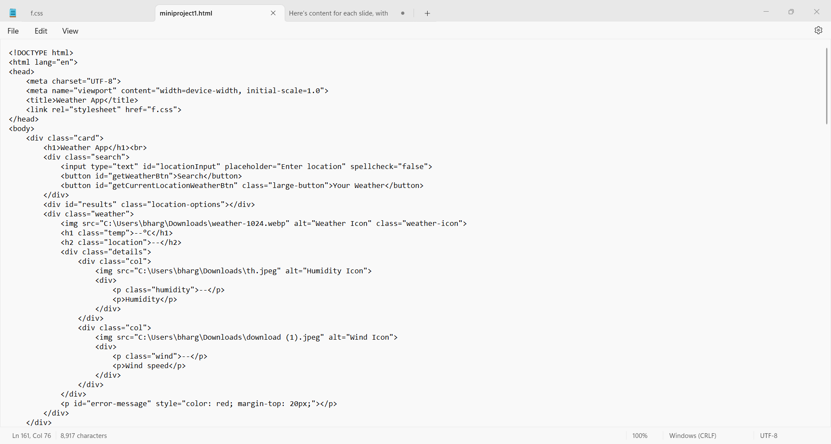
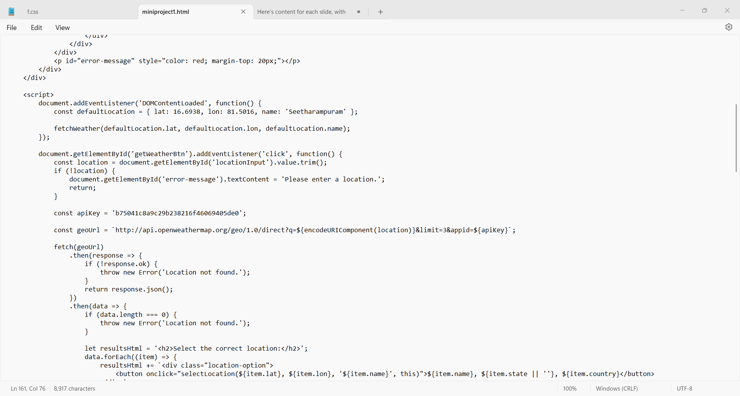
Code Screenshots:
HTML&JAVA SCRIPT Code

Slide 9
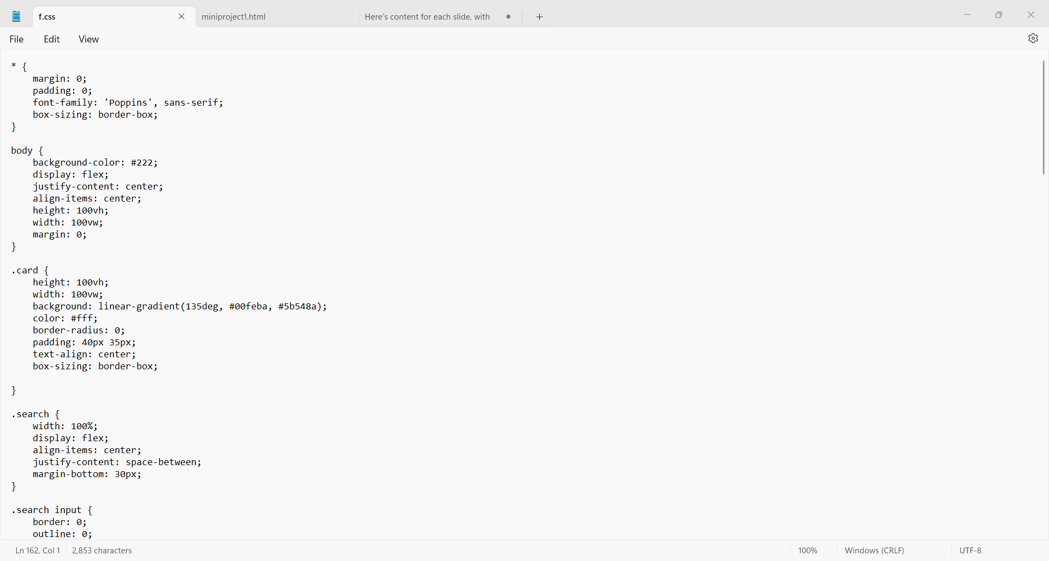
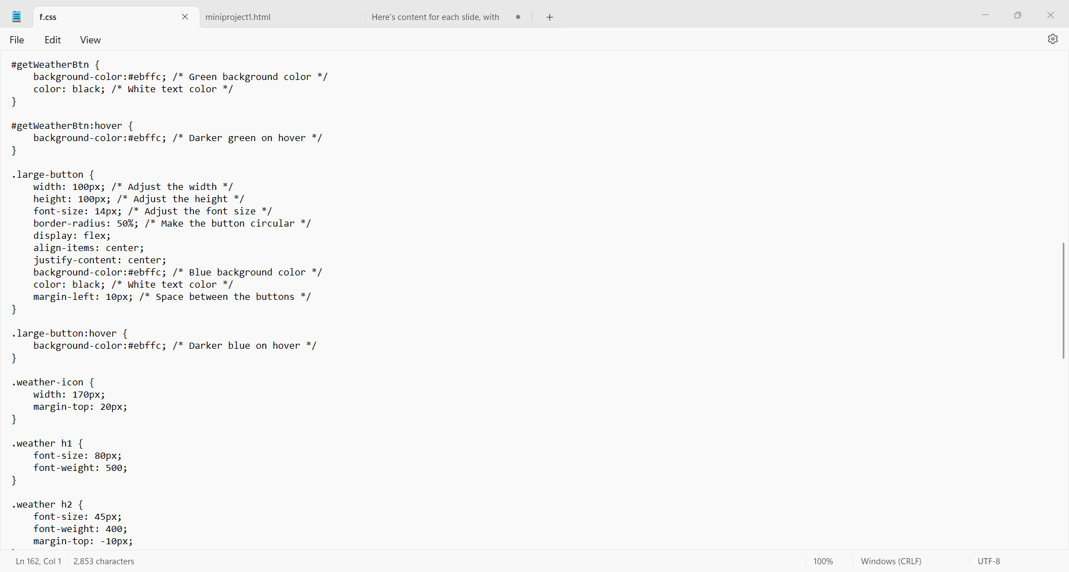
CSS Code

Slide 10
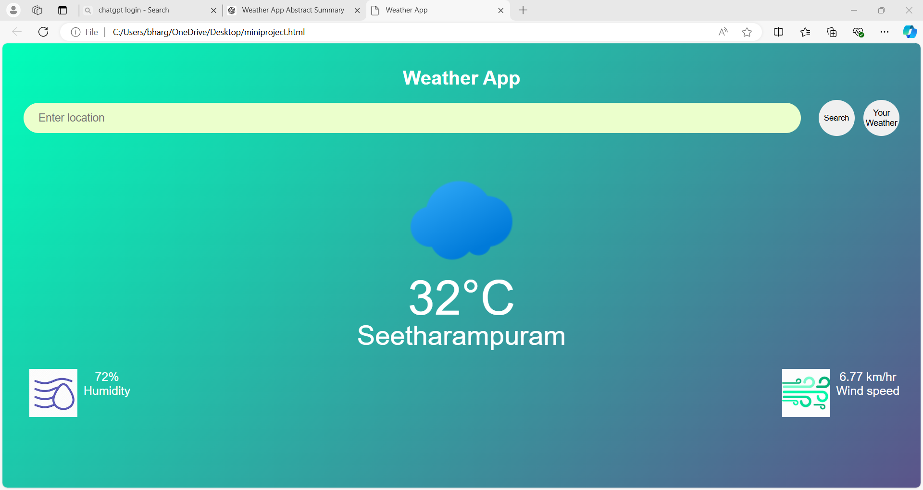
Experimental Results:
Default Location : Seetharampuram

Slide 11
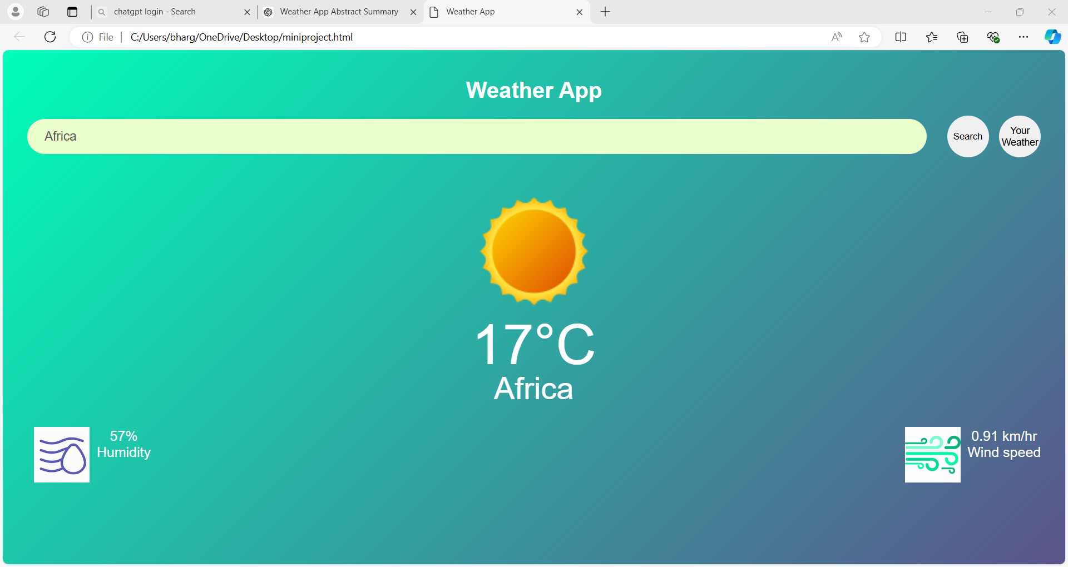
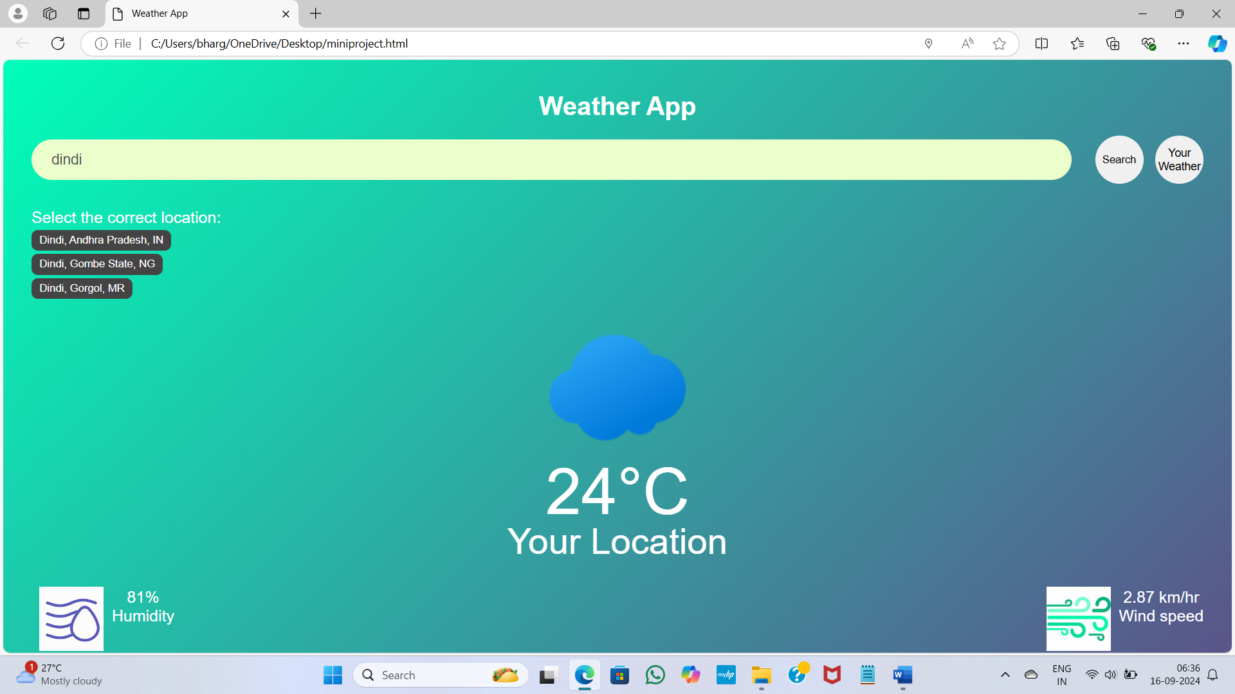

Slide 12
Conclusion:
The weather app effectively fetches and presents real-time weather data in a user-friendly manner.
The project highlights successful integration of APIs and frontend development skills.
Future enhancements might include advanced weather forecasting features or map integration.
d

Slide 13

Reference:
OpenWeatherMap API Documentation: [OpenWeatherMap API](https://openweathermap.org/api)
YouTube Tutorials on Weather App Development: [Weather App Development - YouTube Playlist](https://www.youtube.com/playlist?list=PL5tZ-4Atj8XOnBkd1sDpXqkJX2sy5kZ3h)
GitHub: https://github.com
d

Slide 14

THANK YOU!!
d

